Slide 1
Sample Files
Input
Config.xml
Configuration of the simulation in XML format
Geometry.stl
Geometry of the environment in STL ascii format
You can create STL file using “Blender”
HalfLengthDipole.dat
Tx and Rx antenna pattern
ReceiverPositions.dat
Rx positions
Output
CSV files for plotting
VTK files for visualization using “Paraview”
You can control the output by editing “Config.xml”

Slide 2
Sample Files
Solver
RayTubeTracing.exe
Load “Config.xml” at the current directory and solve the problem according to the configuration
Helper scripts (optional)
MakeReceivers.m
Generate one dimensional receiving points
PlotReceivedPower.m
Load Receivedpowers.csv and plot
OpenCmd.bat
Just open the command prompt at current directory
Simulate.bat
Call the executable and print useful information

Slide 3
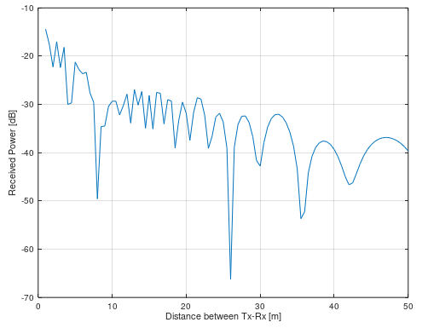
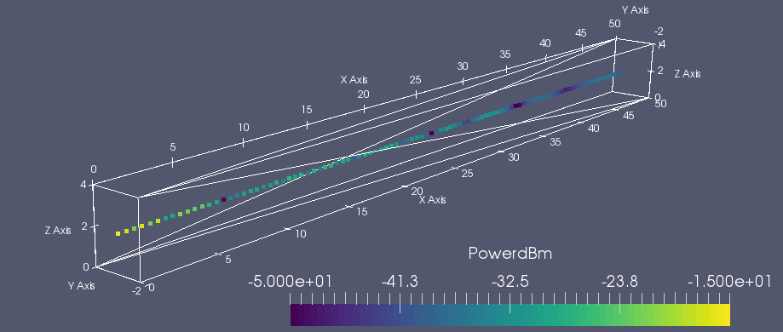
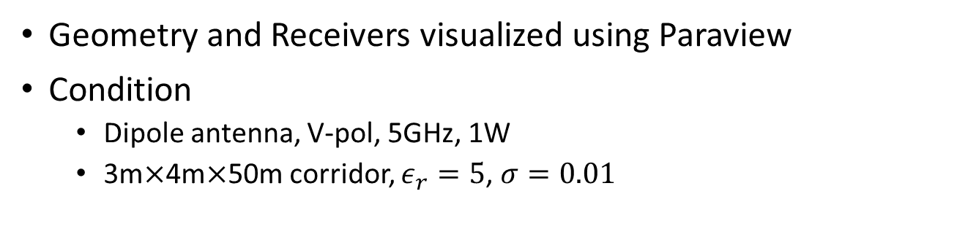
Sample Files
Geometry and Receivers visualized using Paraview
Condition
Dipole antenna, V-pol, 5GHz, 1W
3m$×$4m$×$50m corridor, $ε_{r}=5$, $σ=0.01$

